Slide 1
Trees

Slide 2
Trees
Natural structures for representing certain kinds of hierarchical data. (How our files get saved under hierarchical directories)
Allows us to associate a parent-child relationship between various pieces of data and allows arrange our records, data and files in a hierarchical fashion.
Have many uses in computing. For example a parse-tree can represent the structure of an expression.
Binary Search Trees help to order the elements in such a way that the searching takes less time as compared to other data structures.( speed advantage over other D.S)

Slide 3
Trees
Linked list is a linear D.S and for some problems (Example: DNS in internet) it is not possible to maintain this linear ordering.
Using non linear D.S such as trees and graphs more complex relations can be expressed.

Slide 4
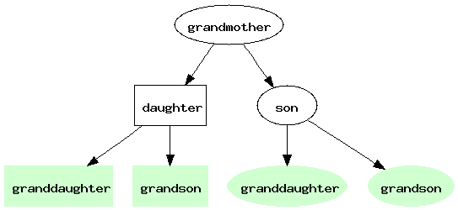
A Family Tree

Slide 5
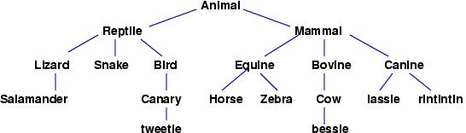
tree of species, from zoology

Slide 6
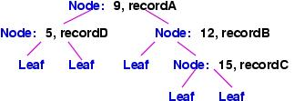
Ordered Tree or Search Tree

Slide 7
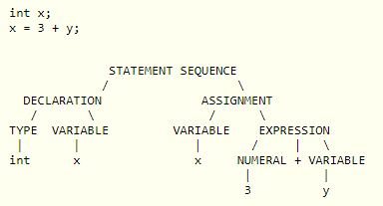
Parse Tree

Slide 8
Pedigree Genealogical Chart
A chart like an inverted branching tree showing the lines of descent of a family or of an animal species.
Cheryl
Kevin
Rosemary
John
Terry
Richard
Kelly
Jack
Mary
Anthony
Karen
Joe
Michelle
Mike
Angela
Binary Tree
Notes:
a chart like an inverted branching tree showing the lines of descent of a family or of an animal species.

Slide 9
Lineal Genealogical Chart
Proto Indo-European
Italic
Hellenic
Germanic
Osco-Umbrian
Latin
Greek
North Germanic
West Germanic
Osco
Umbrian
Spanish
French
Italian
Icelandic
Norwegian
Swedish
Low
High
Yiddish
Notes:
A lineal chart describes the ancestry of the modern European languages. This is a chart of descendants rather than ancestors. For instance, Latin is the precursor(ancestor) of Spanish, French and Italian

Slide 10
Trees
Definition: A tree is a finite set of one or more nodes such that:
There is a specially designated node called the root.
The remaining nodes are partitioned into n ≥ 0 disjoint sets T₁, …, T_{n}, where each of these sets is a tree. We call T₁, …, T_{n} the subtrees of the root.

Slide 11
A Sample Tree
Level
A
1
B
C
D
2
E
F
G
H
I
J
3
K
L
M
4

Slide 12
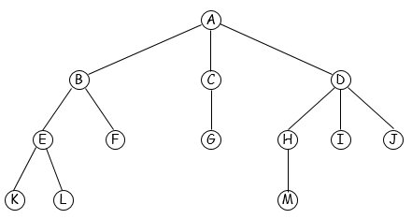
4.1 Tree Terminology
Normally we draw a tree with the root at the top.
A node stands for the item of information plus the branches to other nodes.
The degree of a node is the number of subtrees of the node. [Degree of A=3, C=1, F=0]
A node with degree zero is a leaf or terminal node.
[K L F G M I J]
A node that has subtrees is the parent of the roots of the subtrees, and the roots of the subtrees are the children of the node.
[Children of B = E and F, parent of B is A]
Children of the same parents are called siblings. [E and F]

Slide 13
Tree Terminology (Cont.)
The degree of a tree is the maximum degree of the nodes in the tree. [Degree of above tree = 3]
The ancestors of a node are all the nodes along the path from the root to the node.
ancestors of K = A, B and E
The descendants of a node are all the nodes that are in its subtrees.
Assume the root is at level 1, then the level of a node is the level of the node’s parent plus one.
The height or the depth of a tree is the maximum level of any node in the tree. [depth of the ex tree = 4]

Slide 14
4.2 Representation of trees

Slide 15
List Representation of Trees
Information in root node comes first, followed by a list of the subtrees of that node.
The example tree could be written as
(A (B (E (K, L), F), C(G), D(H (M), I, J)))
A
0
B
F
0
C
G
0
D
I
J
0
List Representation of example tree
E
K
L
0
H
M
0
Data | Child1 | Chid2 | .. | Childk
Possible Node Structure for a tree

Slide 16
Left Child-Right Sibling Representation
Each node has two links (or pointers).
One leftmost child and one closest right sibling.
A
data
left child
right sibling
B
C
D
E
F
G
H
I
J
K
L
M

Slide 17
Degree Two Tree Representation
A
A
A
B
B
B
A
A
A
B
C
B
C
B
C
Original tree
Left child-right sibling
Degree two tree or Binary tree

Slide 18


Degree Two Tree Representation
Rotate the right sibling pointers in a left child right sibling tree clockwise by 45 degrees. We refer to the two children of a node as left and right children.
A
Left Child – Right Child trees are also know as Binary Trees
B
E
C
Original tree
K
F
G
D
L
H
M
I
Left Child-Right Sibling representation
Degree two tree representation
J

Slide 19
4.3 Binary Trees
Definition: A binary tree is a finite set of nodes that is either empty or consists of a root and two disjoint binary trees called the left subtree and the right subtree.
The degree of any given node in a binary tree must not exceed two.
Binary tree distinguishes between the order of the children while in a tree we do not.

Slide 20
Binary Tree Examples
A
A
A
B
B
C
B
C
D
E
F
G
A
D
H
I
B
E
Skewed Binary Tree
Complete Binary Tree

Slide 21
The Properties of Binary Trees
Lemma 5.2 [Maximum number of nodes]
The maximum number of nodes on level i of a binary tree is 2^{i-1}, i ≥ 1.
The maximum number of nodes in a binary tree of depth k is 2^{k} – 1, k ≥ 1.
A
1
A
B
C
2
B
C
D
E
F
G
3
D
E
F
G
H
I
4
H
I
J
K
L
M
N
O
Level
Maximum no of nodes

Slide 22
The Properties of Binary Trees
Lemma 5.3
[Relation between number of leaf nodes and nodes of degree 2]:
For any non-empty binary tree, T, if n₀ is the number of leaf nodes and n₂ the number of nodes of degree 2, then n₀ = n₂ + 1.

Slide 23
A
B
C
D
E
F
G
H
I

Slide 25
Full binary Tree
Definition: A full binary tree of depth k is a binary tree of depth k having 2^{k} – 1 nodes, k ≥ 0 (i.e having the maximum number of nodes). In this every node other than the leaves has two children.
level
1
1
2
2
3
4
5
6
7
3
8
9
10
11
12
13
14
15
4
Full Binary Tree of depth 4 with sequential node numbers

Slide 26
Complete binary tree
Definition: A binary tree with n nodes and depth k is complete iff its nodes correspond to the nodes numbered from 1 to n in the full binary tree of depth k. In a complete binary tree, every level, except possibly the last, is completely filled, and all nodes are as far left as possible.
A
A
B
C
B
C
D
E
F
D
E
F
G
H
I
Not a complete binary tree
H
I
Complete binary tree

Slide 27
Storage representation of binary trees:
Trees can be represented using
Linear/Sequential (Array) Representation
Linked Representation

Slide 28
Array Representation of A Binary Tree
Lemma 5.4: If a complete binary tree with n nodes is represented sequentially, then for any node with index i, 1 ≤ i ≤ n, we have:
parent(i) is at if i ≠1. If i = 1, i is at the root and has no parent.
left_child(i) is at 2i if 2i ≤ n. If 2i > n, then i has no left child.
right_child(i) is at 2i + 1 if 2i + 1 ≤ n. If 2i + 1 > n, then i has no right child.
Position zero of the array is not used.

Slide 29
Array Representation of Binary Trees
A
[1]
A
[1]
A
[2]
B
A
[2]
B
[3]
[3]
C
B
[4]
C
B
C
[4]
D
[5]
[5]
E
C
[6]
[6]
F
D
E
F
G
[7]
[7]
G
[8]
D
[8]
H
D
[9]
H
I
[9]
I
E
[16]
E

Slide 30
Advantages and disadvantages of Array representation
Advantages:
This representation is very easy to understand.
This is the best representation for full and complete binary tree representation.
Programming is very easy.
It is very easy to move from a child to its parents and vice versa.
Disadvantages:
Lot of memory area wasted.
Insertion and deletion of nodes needs lot of data movement.
This is not suited for trees other than full and complete tree.

Slide 31
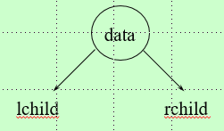

Linked Representation
typedef struct node *Nodeptr;
struct node{
int data;
Nodeptr rchild;
Nodeptr lchild;
};

Slide 32
Node Representation
data
lchild
rchild
lchild
data
rchild

Slide 33
Linked List Representation For The Binary Trees
root
root
A
0
A
B
0
B
C
C
0
D
0
D
E
F
0
G
0
0
E
0
H
0
I
0

Slide 34
Advantages and disadvantages of linked representation
Advantages
A particular node can be placed at any location in the memory.
Insertions and deletions can be made directly without data movements.
It is best for any type of trees.
It is flexible because the system take care of allocating and freeing of nodes.
Disadvantage
It is difficult to understand.
Additional memory is needed for storing pointers
Accessing a particular node is not easy.

Slide 35
Recursive Function to create a binary tree
Nodeptr CreateBinaryTree(int item){
int x;
if (item!=-1) { //until input is not equal to -1
Nodeptr temp = getnode();
temp->data = item;
printf("Enter the lchild of %d :",item);
scanf("%d",&x);
temp->lchild = CreateBinaryTree(x);
printf("Enter the rchild of %d :",item);
scanf("%d",&x);
temp->rchild = CreateBinaryTree(x);
return temp;
}
return NULL;
}

Slide 36
int main()
{
Nodeptr root = NULL;
int item;
printf("Creating the tree : \n");
printf(“Enter the root : “);
scanf("%d",&item);
root=CreateBinaryTree(item);
…

Slide 37
Tree Traversal
Let L, V, and R stand for moving left, visiting the node, and moving right.
There are six possible combinations of traversal for a binary tree
LVR, LRV, VLR, VRL, RVL, RLV
Adopt convention that we traverse left before right, only 3 traversals remain
LVR, LRV, VLR
→inorder, postorder, preorder
When implementing the traversal, a recursion is perfect for the task.

Slide 38
Tree Traversal
Inorder traversal
It can be recursively defined as follows.
Traverse the left subtree in inorder.
Process the root node.
Traverse the right subtree in inorder.

Slide 39
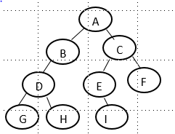
Inorder Traversal
Move towards the left of the tree( till the leaf node), display that node and then move towards right and repeat the process.
Since same process is repeated at every stage, recursion will serve the purpose.
Example:
Inorder traversal of above tree gives GDHBAEICF

Slide 40
Inorder Traversal - Example
Move towards left, we end up in G. G does not have a left child. Now display the root node( in this case it is G). Hence G is displayed first.
Move to the right of G, which is also NULL. Hence go back to root of G and print it. So D is printed next.
Go to the right of D, which is H. Now another root H is visited.
Move to the left of H, which is NULL. So go back to root H and print it and go to right of H, which is NULL.
Go back to the root B and print it and go right of B, which is NULL. So go back to root of B, which is A and print it.
Traversing of left subtree is finished and so move towards right of it & reach C.
Move to the left of C and reach E. Again move to left, which is NULL. Print root E and go to right of E to reach I.
Move to left of I, which is NULL. Hence go back to root I, print it and move to its right, which is NULL.
Go back to root C, print it and go to its right and reach F.
Move to left of F, which is NULL. Hence go back to F, print it and go to its right, which is also NULL.

Slide 41
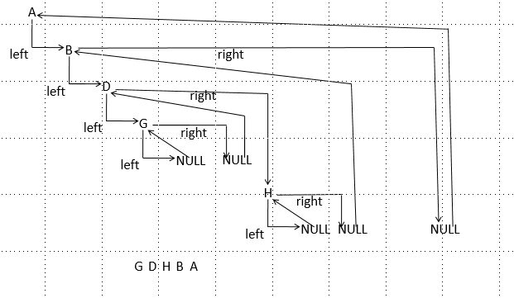

Slide 42
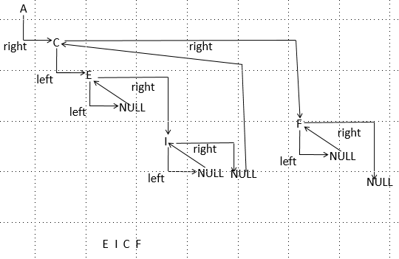

Slide 43
Inorder Traversal
/*recursive algorithm for inorder traversal*/
void inorder(Nodeptr root)
{
if (root)
{
inorder(root→lchild);
printf(“%d “, root→data);
inorder(root→rchild);
}
}

Slide 44
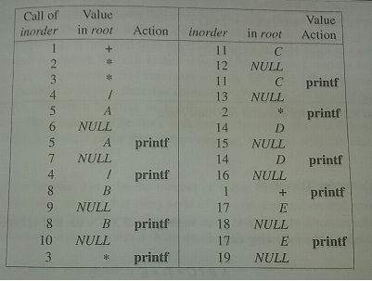
Inorder Traversal Example
+
*
E
*
D
/
C
A
B
Binary tree with operators and operands - Expression tree
Trace of the program
A node that has no action indicates that the node is added to the stack, while a node that has a printf action indicates that the node is removed from the stack.

Slide 45
Preorder Traversal
Preorder traversal is defined as
Process the node.
Traverse the left subtree in preorder.
Traverse the right subtree in preorder.
In preorder,
we first visit the node,
then move towards left
and then to the right
recursively.

Slide 46
Preorder Traversal
void preorder(Nodeptr root)
{
if(root)
{
printf(“%d “, root→data);
preorder(root→lchild);
preorder(root→rchild);
}
}

Slide 47
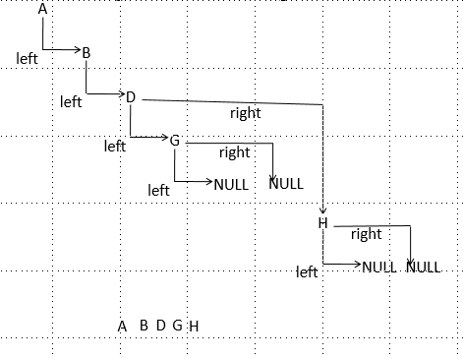
Traversing left sub tree in preorder

Slide 48
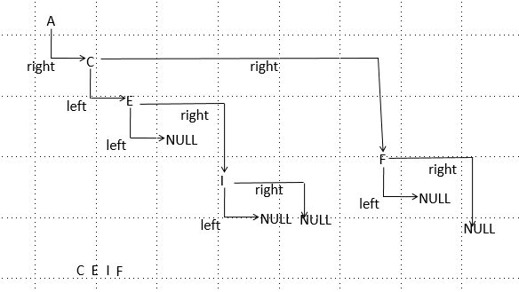
Traversing right sub tree in preorder

Slide 49
Post order traversal
Post order traversal is defined as
Traverse the left subtree in postorder.
Traverse the right subtree in postorder.
Process the root node.
In post order traversal,
we first traverse towards left,
then move to right and
then visit the root.
This process is repeated recursively.

Slide 50
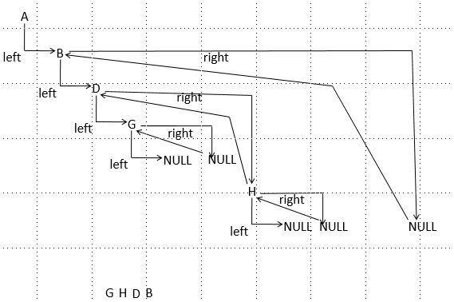
Post order traversal-Example

Slide 51
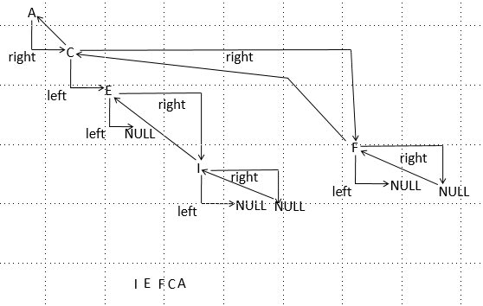
Post order traversal - Example

Slide 52
Post order traversal
void postorder(Nodeptr root)
{
if(root)
{
postorder(root→lchild);
postorder(root→rchild);
printf(“%d “,root→data);
}
}

Slide 53
Binary Tree With Arithmetic Expression
+
*
E
*
D
/
C
A
B

Slide 54
Tree Traversal
Inorder Traversal: A/B*C*D+E
=> Infix form
Preorder Traversal: +**/ABCDE
=> Prefix form
Postorder Traversal: AB/C*D*E+
=> Postfix form

Slide 55
Iterative Inorder Traversal
Every time a node is visited, it is pushed to stack without printing its info and move left.
After finishing left, pop element from stack, print it and move right.
Here 10, 20 , 5 is pushed to stack. Then pop 5, print it and move right.
Now pop 20, print it and move right and push 30 and move left.
Pop 30, print it and move right.
Pop 10, print it and move right and push 40 and so on
10
20
40
5
30

Slide 56
Iterative Inorder Traversal
void iterative_inorder(Nodeptr root)
{
Nodeptr cur;
int done = false;
STACK *s, s1;
s= &s1;
s->top = -1;
if(root==NULL){
printf("Empty Tree\n");
return;
}
cur=root;
while(!done){
while(cur!=NULL){
Push(s, cur);
cur=cur->lchild;
}
if(!IsEmptyStack(s)){
cur=Pop(s);
printf("%d ",cur->data);
cur=cur->rchild;
}
else
done = true;
}
}
+
*
E
*
D
/
C
A
B

Slide 57
Ex:
After 1st iteration of while loop
Node 10 is pushed to stack
cur=cur→lchild i.e cur=20
After 2nd iteration of while loop
Node 20 is pushed to stack
cur=cur→lchild; i.e cur=5
10
20
40
5
30
10
20
10

Slide 58
After 3rd iteration of while loop
Node 5 is pushed to stack
cur=cur→lchild; i.e cur=NULL
4. While loop terminates since cur==NULL
Stack is not empty
cur=pop( );i.e cur=node 5;
Print 5
cur=cur→rchild; i.e cur=NULL
cur==NULL, while loop not entered
Stack not empty
cur=pop( ); i.e cur=node 20
Print 20
cur=cur→rchild; i.e cur=30
5
20
10
20
10
10

Slide 59
6. While loop is entered
Node 30 is pushed to stack
cur=cur→lchild; i.e cur=NULL
7. While loop terminates since cur==NULL
Stack not empty
cur=pop( );i.e cur=node 30;
Print 30
cur=cur→rchild; i.e cur=NULL
8. cur==NULL, while loop not entered
Stack not empty
cur=pop( ); i.e cur=node 10
Print 10
cur=cur→rchild; i.e cur=40
30
10
10

Slide 60
9. While loop is entered
Node 40 is pushed to stack
cur=cur→lchild; i.e cur=NULL
10. While loop terminates since cur==NULL
Stack not empty
cur=pop( );i.e cur=node 40;
Print 40
cur=cur→rchild; i.e cur=NULL
11. cur==NULL and stack empty
return
Hence elements printed are: 5 20 30 10 40
40

Slide 61
Iterative postorder traversal
Here a flag variable to keep track of traversing. Flag is associated with each node. Flag== -1 indicates that traversing right subtree of that node is over.
Algorithm:
Traverse left and push the nodes to stack with their flags set to 1, until NULL is reached.
Then flag of current node is set to -1 and its right subtree is traversed. Flag is set to -1 to indicate that traversing right subtree of that node is over.
Hence is flag is -1, it means traversing right subtree of that node is over and you can print the item. if flag is not –ve, traversing right is not done, hence traverse right.

Slide 62
Iterative Postorder Traversal
/*function for iterative postorder traversal*/
void postorder(Nodeptr root)
{
struct stack
{
Nodeptr node;
int flag;
};
Nodeptr cur;
struct stack s[20];
int top=-1;
if(root==NULL)
{
printf(“tree is empty”);
return;
}

Slide 63
cur=root;
for(; ;){
while(cur!=NULL){ //traverse left and push the nodes to the stack and set flag to 1
s[++top].node=cur;
s[top].flag = 1;
cur=cur→llink;
}
while(s[top].flag<0){ //if flag is –ve, right subtree is visited and hence node is popped and printed
cur=s[top--].node;
printf(“%d”, cur→info);
if(stack_empty(top)) //if stack is empty, traversal is complete
return;
}
cur= s[top].node; //after left subtree is traversed, move to right and set its flag to -1 to //indicate right subtree is traversed*/
cur=cur→rlink;
s[top].flag = -1;
}
}

Slide 64
Ex:
Initially cur =10;
After 1st iteration of 1st while loop
Node 10 is pushed to stack & its flag set to 1.
cur=cur→lchild; i.e cur=20
After 2nd iteration of 1st while loop
Node 20 is pushed to stack & its flag set to 1
cur=cur→lchild; i.e cur=5
10
20
40
5
30
10
1
20
1
10
1

Slide 65
5
1
After 3rd iteration of 1st while loop
Node 5 is pushed to stack & its flag set to 1.
cur=cur→lchild; i.e cur=NULL
4. While loop terminates since cur==NULL
Since s[top].flag!=-1, 2nd while not entered.
cur=s[top].node; i.e cur=node 5;
cur=cur→rchild; i.e cur=NULL;
s[top].flag =-1
cur==NULL, 1st while loop not entered
Since s.[top].flag<0, 2nd while is entered.
cur=s[top].node; i.e cur=node 5;
Print 5
Stack is not empty, continue;
20
1
10
1
5
-1
20
1
10
1
20
1
10
1

Slide 66
6. s[top].flag!=-1, 2nd While loop is exited
cur=s[top].node; i.e cur=20;
cur=cur→rchild; i.e cur=30;
s[top].flag =-1
7. 1st while is entered
Node 30 is pushed to stack & its flag set to 1.
cur=cur→lchild; i.e cur=NULL
cur==NULL, 1st while loop exits
Since s[top]!=-1, 2nd while not entered.
cur=s[top].node; i.e cur=30;
cur=cur→rchild; i.e cur=NULL;
s[top].flag =-1
20
-1
10
1
30
1
20
-1
10
1
30
-1
20
-1
10
1

Slide 67
9. cur==NULL, 1st while loop not entered
Since s.[top].flag<0, 2nd while is entered.
cur=s[top].node; i.e cur=node 30;
Print 30
Stack is not empty, continue;
10. s[top].flag<0, 2nd While loop continues
cur=s[top].node; i.e cur=node 20;
Print 20
Stack is not empty, continue;
11. s[top].flag!=-1, 2nd While loop is exited
cur=s[top].node; i.e cur=10;
cur=cur→rchild; i.e cur=40;
s[top].flag =-1
20
-1
10
1
10
1
10
-1

Slide 68
12. 1st while is entered
Node 40 is pushed to stack & its flag set to 1.
cur=cur→lchild; i.e cur=NULL
13. cur==NULL, 1st while loop exits
Since s[top]!=-1, 2nd while not entered.
cur=s[top].node; i.e cur=40;
cur=cur→rchild; i.e cur=NULL;
s[top].flag =-1
14. cur==NULL, 1st while loop not entered
Since s.[top].flag<0, 2nd while is entered.
cur=s[top].node; i.e cur=node 40;
Print 40
Stack is not empty, continue;
40
1
10
-1
40
-1
10
-1
10
-1

Slide 69
15. s[top].flag<0, 2nd While loop continues
cur=s[top].node; i.e cur=node 10;
Print 10
Stack is empty, stop;
Hence elements printed in postorder are: 5, 30, 20, 40, 10

Slide 70
Iterative Preorder Traversal
void preorder(NODEPTR root)
{
STACK *s, s1;
s= &s1;
s->top = -1;
Nodeptr cur;
if(root==NULL){
printf(“tree is empty”);
return;
}

Slide 71
Push(s, root);
while(!IsEmpty(s)){
cur = Pop(s);
printf(“%d ”, cur->data);
if (cur->rchild) Push(s, cur->rchild);
if (cur->lchild) Push(s, cur->lchild);
}

Slide 72
Ex:
Node 10 is pushed to stack
1. After 1st iteration of while loop
cur = Pop(s);
i.e 10 is popped and printed
cur→rchild and cur->lchild are pushed
i.e 40 and 20 are pushed
2. After 2nd iteration of while loop
cur = Pop(s);
i.e 20 is popped and printed
cur→rchild and cur->lchild are pushed
i.e 30 and 5 are pushed
10
20
40
5
30
10
20
40
5
30
40

Slide 73
3. After 3rd iteration of while loop
cur = Pop(s);
i.e 5 is popped and printed
cur→rchild and cur->lchild are NULL
Hence No Push
4. After 4th iteration of while loop
cur=pop( );
i.e 30 is popped and printed;
cur→rchild and cur->lchild are NULL
Hence No Push
5. After 5th iteration of while loop
cur=pop( );
i.e 40 is popped and printed;
cur→rchild and cur->lchild are NULL
Hence No Push
30
40
40

Slide 74
10. While loop terminates since stack is empty
Hence elements printed are 10, 20, 5, 30, 40

Slide 75
Level-Order Traversal
All previous mentioned schemes use stacks.
Level-order traversal uses a queue.
Level-order scheme visits the root first, then the root’s left child, followed by the root’s right child.
All the node at a level are visited before moving down to another level.

Slide 76
Level-Order Traversal of A Binary Tree
void Levelorder(Nodeptr root){
QUEUE *q, q1;
q = &q1;
q->Front= -1;
q->Rear = -1;
if (root== NULL) {
printf("\nEmpty Tree\n");
return;
}
InsertQ(q,root);
while(!IsEmpty(q)){
Nodeptr temp= DeleteQ(q);
printf("%d ", temp->data);
if (temp->lchild) InsertQ(q,temp->lchild);
if (temp->rchild) InsertQ(q,temp->rchild);
}
}
+
*
E
*
D
/
C
A
B
+*E*D/CAB

Slide 77
Insertion into a binary Tree
A node can be inserted in any position in a tree( unless it is a binary search tree)
A node cannot be inserted in the already occupied position.
User has to specify where to insert the item. This can be done by specifying the direction in the form of a string.
For ex: if the direction string is “LLR”, it means start from root and go left(L) of it, again go left(L) of present node and finally go right(R) of current node. Insert the new node at this position.

Slide 78
For the above tree if the direction of insertion is “LLR”
Start from root. i.e A and go left. B is reached.
Again go left and you will reach C.
From C, go right and insert the node.
Hence the node is inserted to the right of C.
To implement this, we make use of 2 pointer variables parent and cur. At any point parent points to the parent node and cur points to the child.
A
B
E
C
D
F
G

Slide 79
void insert(Nodeptr root, char direction[], int ele) { // assume root is already created and tree exists
int i;
Nodeptr temp,cur,parent;
temp= getnode();
temp->data=ele;
temp->lchild=temp->rchild=NULL;
parent = NULL;
cur=root;
i=0;
while (cur && direction[i]) {//traverse down the tree
parent = cur;
if(direction[i]=='L' || direction[i]=='l')
cur=cur->lchild;
else
cur=cur->rchild;
i++;
}
if ((cur != NULL) || (direction[i]!='\0')) { /*node already present at specified pos/incorrect dir string */
printf("Insertion Not possible\n") ;
free(temp);
return;
}
/*Based on last character of direction string insert as a left or right child */
if(direction[i-1]=='L' || direction[i-1]=='l')
parent->lchild=temp;
else
parent->rchild=temp;
}

Slide 80
Control comes out of while loop, if direction[i] == ‘\0’ or when cur==NULL.
For insertion to be possible, control should come out when cur==NULL and direction[i] == ‘\0’ both at the same time.
i.e when we get the position to insert(cur==NULL), the string should be completed.

Slide 81
Let the direction string be “LLR”. String length of string is 3.
Initially cur ==root and parent==NULL
Loop 1: i=0 ,direction[0]=‘L’
B
C
D
A
parent
B
cur
C
D
A

Slide 82
Loop 2: i=1, direction[1]=‘L’
Loop 3: i=2, directiom[2]=‘R’
i=3, Now loop terminates since cur==NULL. Here i==3(i.e direction[i] == ‘\0’ ) and cur==NULL. Hence insertion is possible
B
parent
C
D
cur
A
B
C
D
parent
A
Cur==NULL

Slide 83
Now direction[i-1] is direction[3-1] which gives ‘R’.
Hence parent→rchild is made to point to new node.
After insertion tree looks like
If direction of insertion is “LLR” for the above tree. Here the loop terminates when direction[i] == ‘\0’. But at this point cur is not equal to NULL. Hence insertion is not possible.
B
C
D
A
F

Slide 84
Some Other Binary Tree Functions
With the inorder, postorder, or preorder mechanisms, we can implement all needed binary tree functions. E.g.,
Copying Binary Trees
Testing Equality
Two binary trees are equal if their topologies are the same and the information in corresponding nodes is identical.

Slide 85
Searching:
Searching an item in the tree can be done while traversing the tree in inorder, preorder or postorder traversals.
While visiting each node during traversal, instead of printing the node info, it is checked with the item to be searched.
If item is found, search is successful.

Slide 86
Searching a binary tree
int Search(Nodeptr root,int ele) //uses preorder traversal
{
static int t=0;
if(root)
{
if(root->data==ele){
t++;
return t;
}
if (t==0) Search(root->lchild,ele);
if (t==0) Search(root->rchild,ele);
}
}

Slide 87
Creating a copy of a binary tree
Getting the exact copy of the given tree.
/*recursive function to copy a tree*/
Nodeptr copy (Nodeptr root){
Nodeptr temp;
if(root == NULL)
return NULL;
temp=getnode();
temp→data=root→data;
temp→lchild=copy(root→lchild);
temp→rchild=copy(root→rchild);
return temp;
}

Slide 88
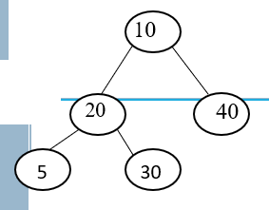
Finding height of a binary tree
/*recursive function to find the height of a tree*/
int height (NODEPTR root)
{
if(root==NULL)
return 0;
return( 1+ max(height (root→lchild), height(root→rchild)));
}
/*max function*/
int max(int a, int b){
if(a>b)
return a;
else
return b;
}

Slide 89
Finding height of a binary tree
Counting the number of nodes in a tree:
Traverse the tree in any of the 3 techniques and every time a node is visited, count is incremented.
void count_nodes( Nodeptr root)
{
static int count = 0;
if(root!=NULL)
{
count_nodes(root→llink);
count++;
count_nodes(root→rlink);
}
return count;
}

Slide 90
Counting the number of leaf nodes in a binary tree
Every time a node is visited, check whether the right and left link of that node is NULL. If yes, count is incremented.
/*counting number of leaf nodes using inorder technique*/
int count_leafnodes( Nodeptr root){
static int count = 0;
if(root!=NULL){
if(root->lchild==NULL && root->rchild==NULL)
count++;
count_leafnodes(root->lchild);
count_leafnodes(root->rchild);
}
return count;
}

Slide 91
Equality of 2 binary trees
Returns FALSE if the binary trees root1 and root2 are not equal otherwise returns TRUE
int Equal( Nodeptr root1, Nodeptr root2)
{
return ((!root1 && !root2) || (root1 && root2 && (root1→data == root2→data) && Equal( root1->lchild,root2->lchild) && Equal ( root1->rchild,root2->rchild));
}

Slide 92
Applications of binary trees
Conversion of expressions:
An infix expression consisting of operators and operands can be represented using a binary tree with root as operator.
Non leaf node contains the operator and leaf nodes contain operands.
(3-2) can be represented as
((3-2)*6) can be represented as
-
3
2
*
-
6
3
2

Slide 93
Represent the following expression using binary tree
((6+(3-2)*5)^2)
First innermost parenthesis is considered, which is (3-2) and partial tree is drawn for this
Next tree is extended to include ((3-2)*5)
-
3
2
*
-
5
3
2

Slide 94
After considering (6+(3-2)*5)
After (6+(3-2)*5)^2
+
6
*
-
5
3
2
^
+
2
6
*
-
5
3
2

Slide 95
When the binary tree for infix expression is traversed in inorder technique, infix expression is obtained.
Preorder traversal gives the prefix expression and postorder traversal gives the postorder expression.
Inorder traversal of above tree:(6+(3-2)*5)^2
Preorder traversal: ^+6*-3252
Postorder traversal: 632-5*+2^

Slide 96
Creating a binary tree for postfix expression:
Steps:
Scan the expression from left to right.
Create a node for each symbol encountered.
If the symbol is an operand, push the corresponding node on to the stack.
If the symbol is an operator, pop top node from stack and attach it to the right of the node with the operator. Next pop present top node and attach it to the left of node with the operator. Push the operator node to the stack.
Repeat the process for each symbol in postfix expression. Finally address of root node of expression tree is on top of stack.

Slide 97
Stack of Nodeptr
#define MaxSize 100
typedef struct node *Nodeptr;
typedef struct{
Nodeptr Stack[MaxSize];
int top;
}STACK;
int IsEmptyStack(STACK *s){
if (s->top==-1)
return 1;
else
return 0;
}
void Push(STACK *s,Nodeptr x){
if (s->top==MaxSize-1){
printf("Stack Overflow");
return;
}
s->Stack[++s->top]=x;
}
Nodeptr Pop(STACK *s){
return (s->Stack[s->top--]);
}

Slide 98
/* C function to create a binary tree for postfix expression*/
Nodeptr create_tree( char postfix[])
{
Nodeptr temp;
STACK *s, s1;
s = &s1;
int i=0, k=0;
char symbol;
while((symbol=postfix[i++])!=‘\0’)
{
temp=getnode();
temp→info=symbol;
temp→llink=temp→rlink=NULL;
if(isalnum(symbol)) /* if operand push it*/
Push(s,temp );
else /* else pop element add it to the
{ right of operator node. Pop
temp→rlink=Pop(s); next element and add to
temp→llink=Pop(s); left. Push operator node*/
Push(s, temp)
}
}
return(Pop(s)); /* return root*/
}

Slide 99
Create a binary tree for the given postfix expression:
abc-d*+
First 3 symbols are operands, hence after pushing these 3 symbols, stack of nodes looks like
C
B
A

Slide 100
2. Now we get operator ‘–’. Pop top 2 elements and add them to right and left of node with ‘-’respectively and push node with operator ‘-’ to stack.
-
B
C
-
A

Slide 101
3. Push sumbol ‘D’ to stack
D
-
A

Slide 102
Now the operator is ‘*’. Pop top 2 elements and add it to right and left of node with ‘*’ respectively and push the operator node to stack.
*
-
D
B
C
*
A

Slide 103
Next is the operator ‘+’. Hence after popping and pushing, stack will be
Now stack top will have the root of the final tree.
+
A
*
-
D
B
C
+

Slide 104
Evaluating the expression tree using recursion:
int eval( Nodeptr root)
{
float num;
switch(root→data)
{
case ‘+’:return eval(root→lchild)+ eval(root→rchild);
case ‘-’ :return eval(root→ lchild)- eval(root→rchild);
case ‘/’:return eval(root→lchild)/ eval(root→rchild);
case ‘*’ :return eval(root→ lchild)* eval(root→rchild);
case ‘$’:
case ‘^’:return pow(eval(root→lchild), eval(root→rchild));
default :return(root→data – ‘0’); //base case
}
}

Slide 105
Eval(+)
+
1
*
-
4
3
2
Eval(1)
+
Eval(*)
5
Eval(-)
*
Eval(4)
4
1
4
Eval(3)
Eval(2)
-
1
3
2

